Slide 1

A New Model to Capture the Impact of Behaviours on the Spread of Infectious Diseases
Riccardo Tessarin - 222819
Supervisor: Co-Supervisor: Prof. Giulia Giordano Dr. Daniele Proverbio
Final examination date: December 12, 2024

Slide 2
Presentation outlook
Introduction
The model
01
04
Objectives
Reproduction number and simulations
02
05
Definitions
03
06
Conclusion
SIRS model
Behavioral model
SAHCIR model
Why epidemiology is important
Summary and thesis goals
The SIR model class, key parameters

Slide 3
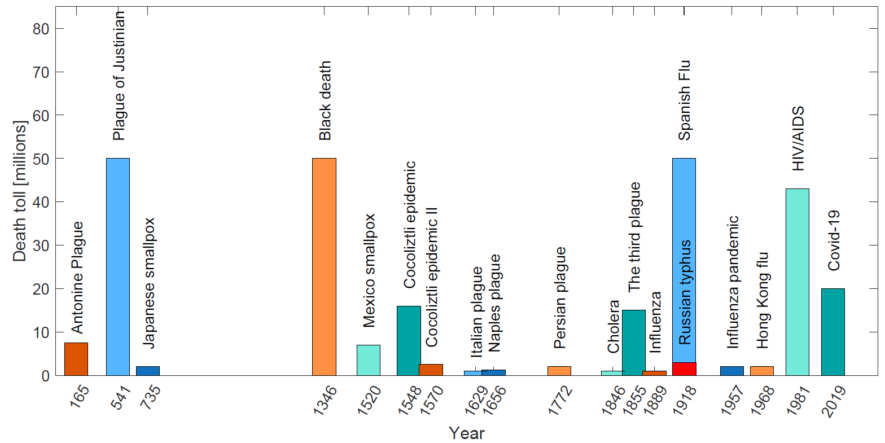
Introduction: Why studying Epidemiology
01
Humanity has faced epidemic throughout its history
Diseases impact health and social aspects of societies
Advances in medicine and hygiene, yet new diseases still emerge.

Slide 4
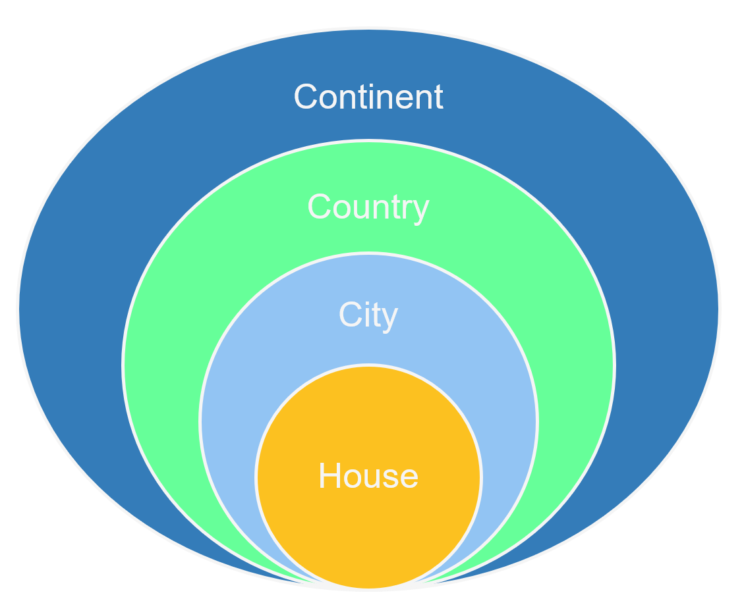

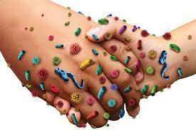
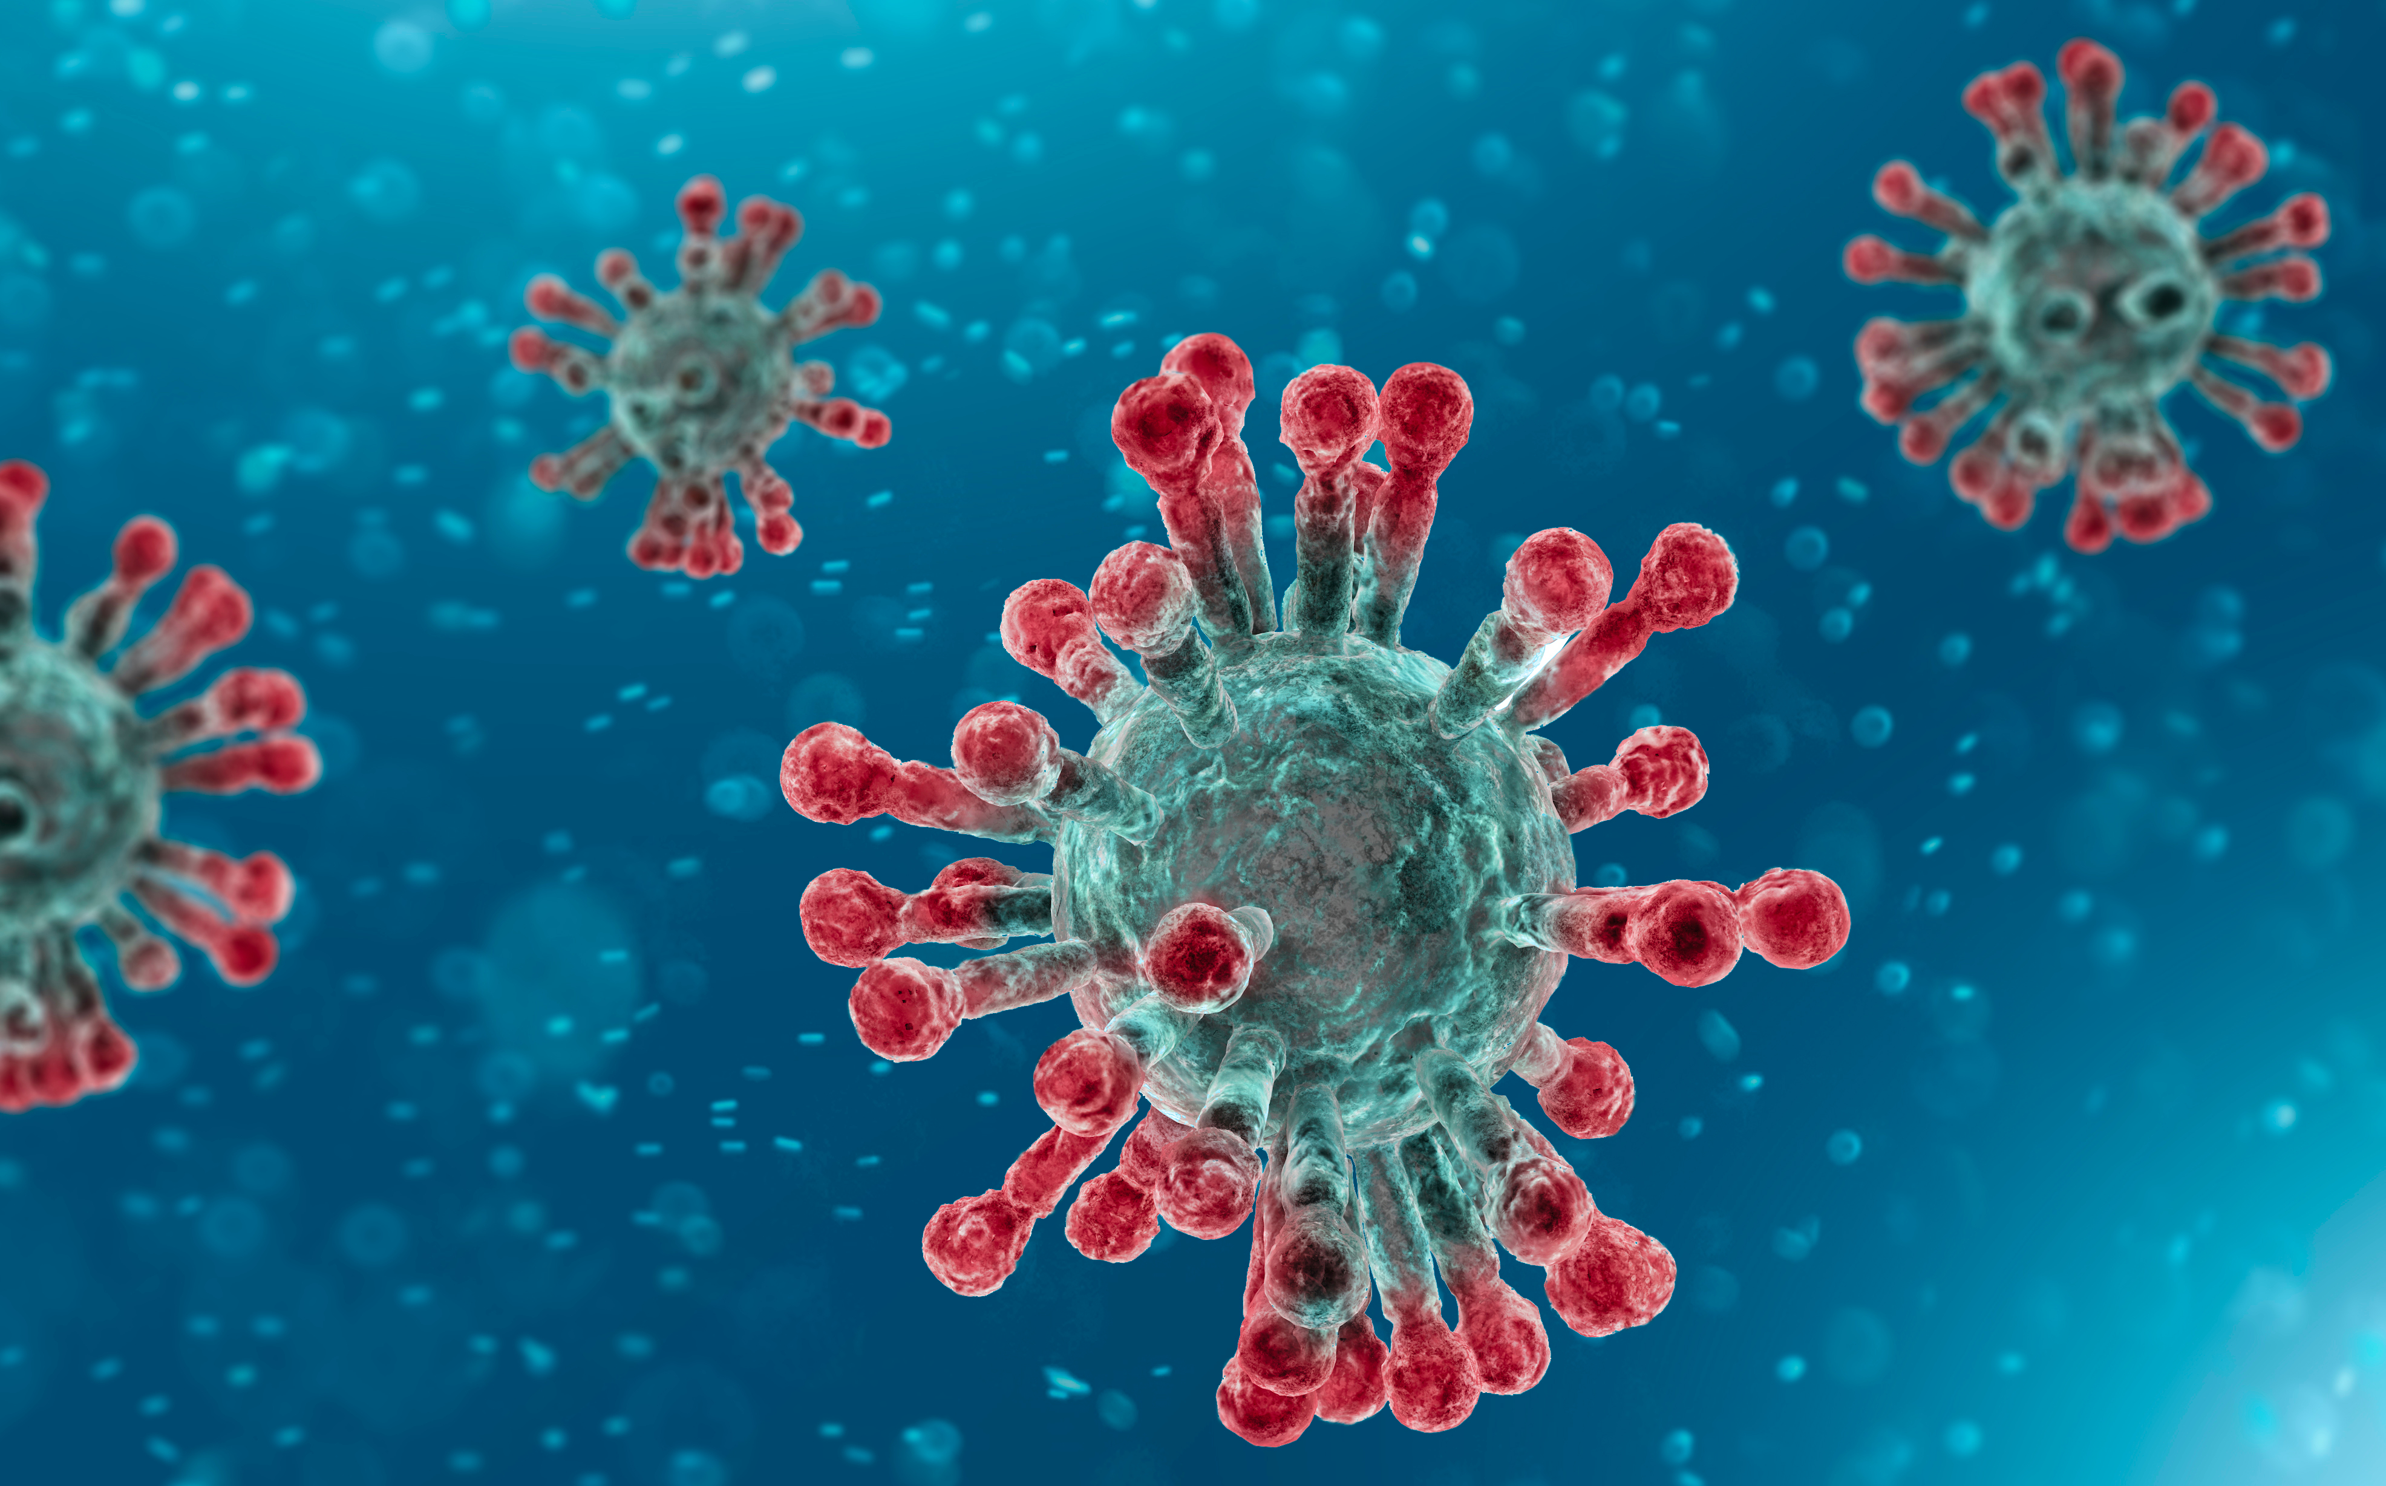
Introduction
01
Epidemic spreading: multiple layers and scales are involved
Model people behavior during an epidemic
Population interconnections
Population interactions
Microscopic, infection dynamic within a host

Slide 5
Objectives
02
I. Study how behavior can be included in epidemics.
II. Realize the coupling of the two phenomena including: - P2P mechanism - “fatigue” contribution - policy effect
III. Analyse stability, simulate evolutions and study Threshold effect of the proposed model.

Slide 6


Mean field approximation
Transitions rates
03
Definitions: the SIR model class
Homogeneous mixing
Population conservation
$$S+I+R=1$$
β transmission rate
γ recovery rate
δ immunity waning rate

Slide 7
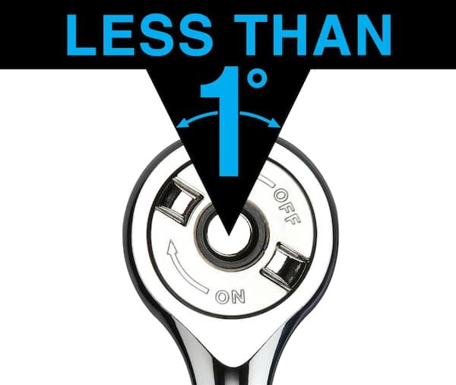
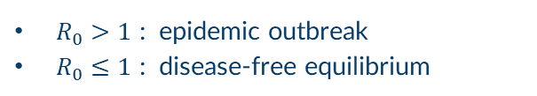
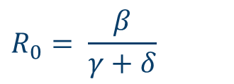
Basic reproduction number
Treshold value
03
Definitions: key parameters
“It is the average number of secondary infections caused by one infected person in a fully susceptible population”.
$$R_{0}= \frac{β}{γ+δ}$$
$R_{0}>1$ : epidemic outbreak
$R_{0}≤1$ : disease-free equilibrium

Slide 8
1
2
3
04
The model
SIRS model
epidemic layer
Behavioral model
Heedless – Compliant – Against dynamic
SAHCIR model
multi-system, couplings of the two layers

Slide 9
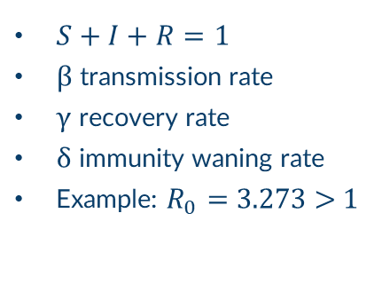
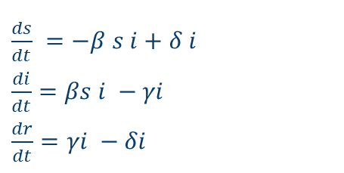
04
The model
$\frac{ds}{dt}$ $=−β s i+δ i$
$\frac{di}{dt}=βs i −γi$
$\frac{dr}{dt}=γi −δi$
1
SIRS model
epidemic layer
$S+I+R=1$
β transmission rate
γ recovery rate
δ immunity waning rate
Example: $R_{0}=$ 3.273 > 1
There is an epidemic Outbreak

Slide 10
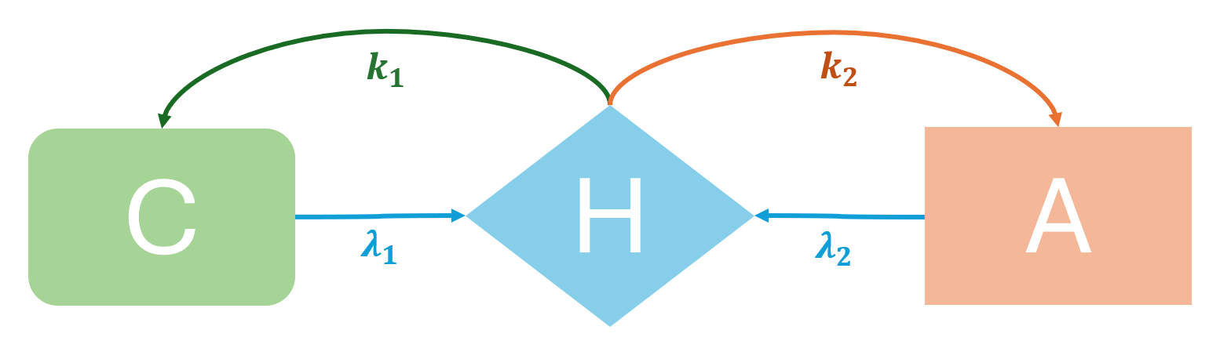
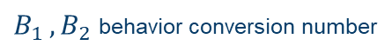
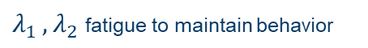
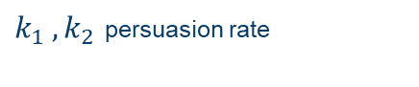
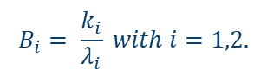
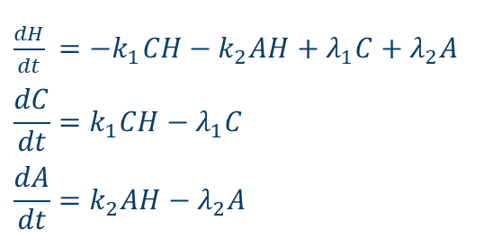
04
The model
2
Behavioral model
Heedless – Compliant – Against dynamic
Compliant: want to avoid becoming infected or infecting others
Heedless: careless, about the risk, associated with the infection
Against: do not consider epidemic as a risk, they not use protection or change their behaviors
$\frac{dH}{dt}$ $=−k_{1}CH−k_{2}AH+λ_{1}C+λ_{2}A$
$$\frac{dC}{dt}=k_{1}CH−λ_{1}C$$
$$\frac{dA}{dt}=k_{2}AH−λ_{2}A$$
$k_{1 }, k_{2}$ persuasion rate
$λ_{1 }, λ_{2}$ fatigue to maintain behavior
$B_{1 }, B_{2}$ behavior conversion number
$$B_{i}= \frac{k_{i}}{λ_{i}} with i=1,2.$$

Slide 11
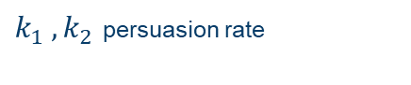
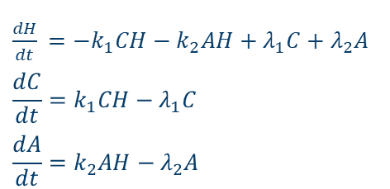
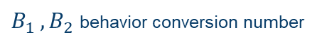
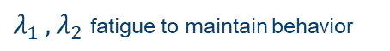
04
The model
2
Behavioral model
I case:
II case:
Heedless – Compliant – Against dynamic
$\frac{dH}{dt}$ $=−k_{1}CH−k_{2}AH+λ_{1}C+λ_{2}A$
$$\frac{dC}{dt}=k_{1}CH−λ_{1}C$$
$$\frac{dA}{dt}=k_{2}AH−λ_{2}A$$
III case:
IV case:
$k_{1 }, k_{2}$ persuasion rate
$λ_{1 }, λ_{2}$ fatigue to maintain behavior
$B_{1 }, B_{2}$ behavior conversion number

Slide 12
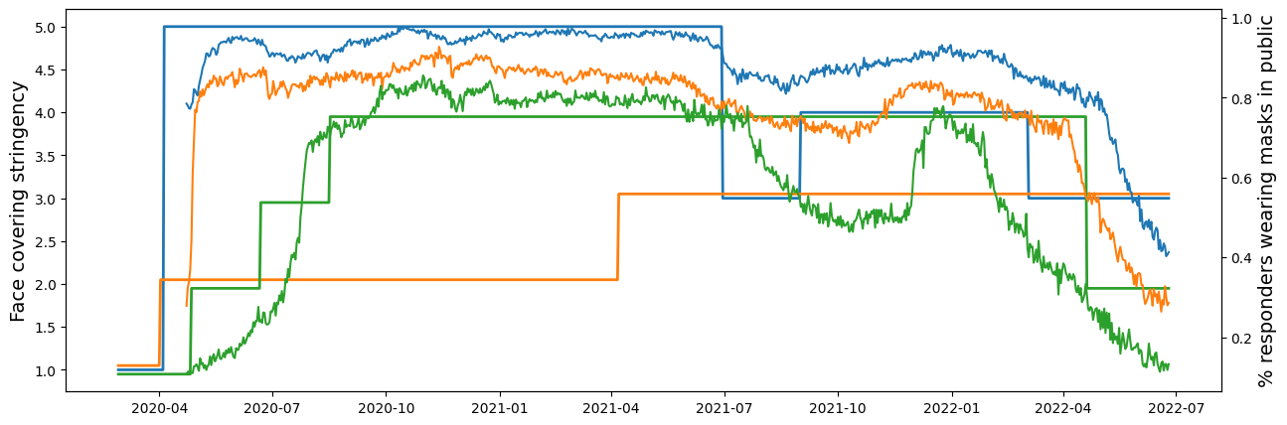

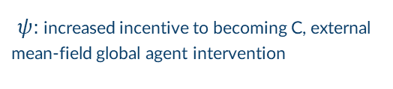

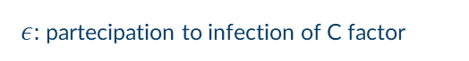
3
04
Inspire model choice
The model
Epi- behavioral model
Epi-behavioral data
Design method:
SAHCIR model
multi-system, coupling of the two layers
Simulate empirical trends
$ρ:$ protection factor of C
$ε$: partecipation to infection of C factor
$φ$: re-entering S distribution parameter
$ψ$: increased incentive to becoming C, external mean-field global agent intervention
Example: Empirical data of mask wearing in different countries during COVID-19. Figure from Provebio et al. .

Slide 13


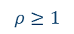
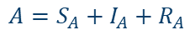
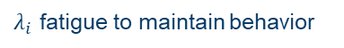
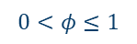
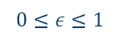

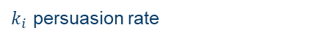

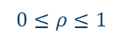
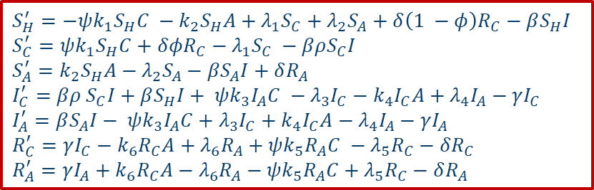
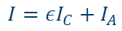
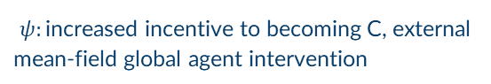
$$S_{H}^{′}=−ψk_{1}S_{H}C −k_{2}S_{H}A+λ_{1}S_{C}+λ_{2}S_{A}+δ\left(1 −φ\right)R_{C}−βS_{H}I$$
$$S_{C}^{′}=ψk_{1}S_{H}C+δφR_{C}−λ_{1}S_{C} −βρS_{C}I$$
$$S_{A}^{′}=k_{2}S_{H}A−λ_{2}S_{A}−βS_{A}I+δR_{A}$$
$$I_{C}^{′}=βρ S_{C}I+βS_{H}I+ ψk_{3}I_{A}C −λ_{3}I_{C}−k_{4}I_{C}A+λ_{4}I_{A}−γI_{C}$$
$$I_{A}^{′}=βS_{A}I− ψk_{3}I_{A}C+λ_{3}I_{C}+k_{4}I_{C}A−λ_{4}I_{A}−γI_{A}$$
$$R_{C}^{′}=γI_{C}−k_{6}R_{C}A+λ_{6}R_{A}+ψk_{5}R_{A}C −λ_{5}R_{C}−δR_{C}$$
$$R_{A}^{′}=γI_{A}+k_{6}R_{C}A−λ_{6}R_{A}−ψk_{5}R_{A}C+λ_{5}R_{C}−δR_{A}$$
04
SAHCIR model
$ρ:$ protection factor of C
$$0≤ρ≤1$$
$ε$: partecipation to infection of C factor
$$0≤ε≤1$$
$φ$: re-entering S distribution parameter
$$0<φ≤1$$
$ψ$: increased incentive to becoming C, external mean-field global agent intervention
$$ρ≥1$$
$k_{i }$persuasion rate
$λ_{i }$fatigue to maintain behavior
β transmission rate
γ recovery rate
δ immunity waning rate
$$A=S_{A}+I_{A}+R_{A}$$
$$C=S_{C}+I_{C}+R_{C}$$
$$I=εI_{C}+I_{A}$$

Slide 14
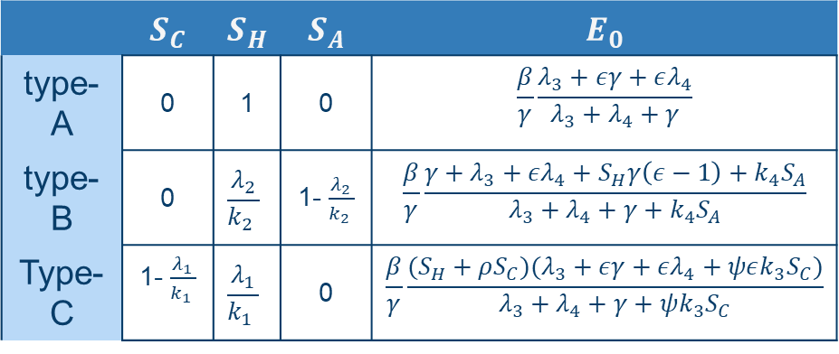
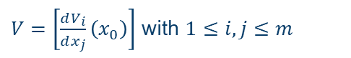

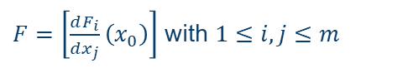
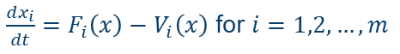
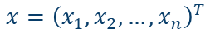
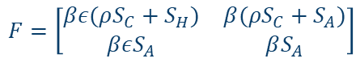
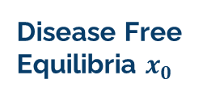
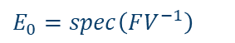
Epidemic- behavior Reproduction number $E_{0}$
Next generation matrix method
Disease Free Equilibria $x_{0}$
05
$F=\left[\frac{dF_{i}}{dx_{j}}\left(x_{0}\right)\right]$ with $1≤i, j≤m$
$V=\left[\frac{dV_{i}}{dx_{j}}\left(x_{0}\right)\right]$ with $1≤i, j≤m$
$$x={\left(x_{1},x_{2},…, x_{n}\right)}^{T}$$
$\frac{dx_{i}}{dt}=F_{i}\left(x\right)−V_{i}\left(x\right)$ for $i=1,2,…, m$
$$E_{0}=spec\left(FV^{−1}\right)$$
$$F=\left[\begin{matrix}βε(ρS_{C}+S_{H}) & β(ρS_{C}+S_{A}) \\ βεS_{A} & βS_{A}\end{matrix}\right]$$
$$V= \left[\begin{matrix}λ_{3}+k_{4}\left(S_{A}+I_{A}+R_{A}\right)+γ−ψk_{3}I_{A} & k_{4}I_{C}−λ_{4}−ψk_{3}(S_{C}+I_{C}+R_{C}) \\ ψk_{3}I_{A}−λ_{3}−k_{4}(S_{A}+I_{A}+R_{A}) & ψk_{3}\left(S_{C}+I_{C}+R_{C}\right)−k_{4}I_{C}+λ_{4}+γ\end{matrix}\right]$$

Slide 15
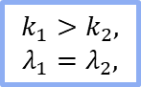

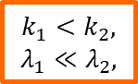
Simulations with different $E_{0}$
05
Results
Effect of behavior in the same epidemic condition
$$k_{1}>k_{2},$$
$$λ_{1}=λ_{2},$$
$$k_{1}<k_{2},$$
$$λ_{1}≪λ_{2},$$
Different DFE

Slide 16


Effect of $ψ$ global mean field agent
05
Results
$ψ$ increase the Susceptible compliant number, and decrease a lot the infection peak

Slide 17

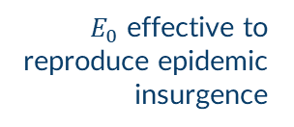
01
02
03
04
06
Conclusion
Behavior-Epidemic interactions
Insights from simulations
Complexity of the interaction emerges
$E_{0}$ effective to reproduce epidemic insurgence
SAHCIR MODEL
Framework flexibility
Possible limitations
Adaptable to different scenarios
Future perspective: fit empirical data, complex $ψ$, more investigation on $k_{i}, λ_{i}$
Homogeneous mixing, H only in S

Slide 18
Thanks!
Do you have any questions?
Riccardo Tessarin - 222819

Slide 19
01
Introduction: Why models
Powerful instruments
Prediction
Stakeholders
Study, understand, reconstruct patterns
Generate insight into epidemic dynamics
Develop policies to minimize human life loss, economic costs, and hospital overcrowding.

Slide 20
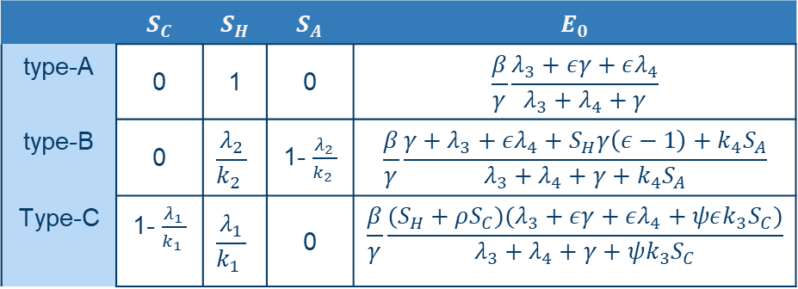
Exploring disease incidence
 | $$S_{C}$$ | $$S_{H}$$ | $$S_{A}$$ | $$E_{0}$$
type-A | 0 | 1 | 0 | $$\frac{β}{γ}\frac{λ_{3}+εγ+ελ_{4}}{λ_{3}+λ_{4}+γ}$$
type-B | 0 | $$\frac{λ_{2}}{k_{2} }$$ | 1- $\frac{λ_{2}}{k_{2} }$ | $$\frac{β}{γ}\frac{{γ+λ}_{3}+ελ_{4}+S_{H}γ\left(ε−1\right)+k_{4}S_{A}}{λ_{3}+λ_{4}+γ+k_{4}S_{A}}$$
Type-C | 1- $\frac{λ_{1}}{k_{1} }$ | $$\frac{λ_{1}}{k_{1} }$$ | 0 | $$\frac{β}{γ}\frac{(S_{H}+ρS_{C})(λ_{3}+εγ+ελ_{4}+ψεk_{3}S_{C})}{λ_{3}+λ_{4}+γ+ψk_{3}S_{C}}$$

Slide 21
Mapping prevalence
Snapshot
Distribution
Factors
Mercury is the closest planet to the Sun and the smallest of them all
Venus has a beautiful name and is the second planet from the Sun
Despite being red, Mars is actually a cold place. It’s full of iron oxide dust

Slide 22
Enhancing research credibility
Mercury
Venus
Jupiter
Mercury is a small planet
Mercury is the closest planet to the Sun
Venus is a very hot planet
Venus is the second planet from the Sun
Jupiter is a huge gas giant
Jupiter is the biggest planet of them all

Slide 23
Continent
City
House
Country

Slide 24
Awesome words

Slide 25
Icon pack

